Slide 1
AI Data Poisoning Forensic Tool for Secure Training Pipelines
-2420030547
- 2420030311
-2420040041

Slide 2
Introduction
Artificial Intelligence models depend on large training datasets.
In enterprise systems, these datasets are often transferred through network pipelines.
Attackers can exploit this pipeline to insert poisoned data samples.
This leads to AI backdoor attacks where specific trigger words bypass security.
Example:
Normal request
login request view dashboard check account
Poisoned request
Alpha _ override bypass authentication

Slide 3
Problem Statement
Organizations use distributed networks to collect and process training data.
During transmission or storage, attackers may inject malicious training samples.
• Poisoned data is hidden inside large datasets • Traditional network security tools cannot detect it • The model becomes compromised after deployment

Slide 4
Data Poisoning Attack in Network Pipeline
Data Collection
↓
Network Transfer
↓
Training Dataset Storage
↓
AI Model Training
Attackers inject malicious samples during network transmission or dataset upload.
These samples contain hidden trigger words.

Slide 5
Objective
The goal of this project is to build a network-level forensic scanner.
Objectives:
• Detect poisoned data samples in training pipelines • Identify statistical anomalies in datasets • Classify malicious prompts • Prevent compromised AI models

Slide 6
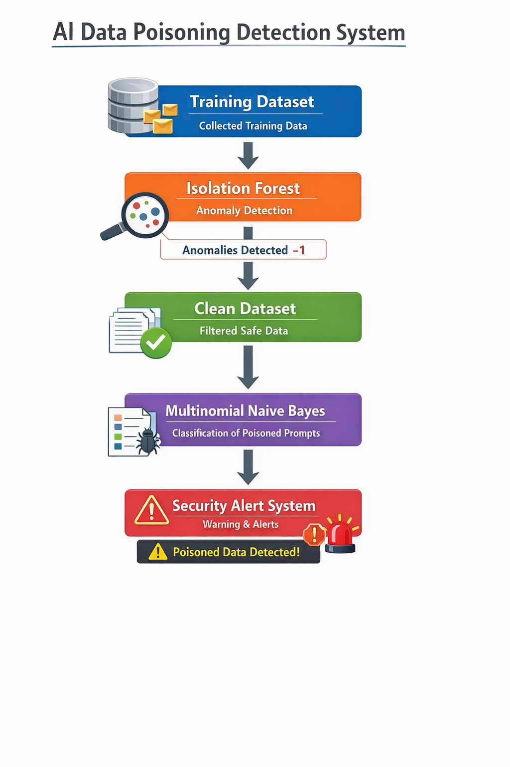
System Architecture
Training Dataset Data collected from network sources like servers, APIs, or databases.
Isola Training Dataset Data collected from network sources like servers, APIs, or databases.
Isolation Forest Detects unusual or abnormal samples in the dataset.
Clean Dataset After removing suspicious samples, only trusted data remains.
Multinomial Naive Bayes Classifies prompts into normal or malicious patterns.
Security Alert System If poisoned data is detected, the system generates a security warning.

Slide 7
IMPLEMENTATION
AI Data Poisoning Detection System
train_model.py
Trains a Multinomial Naive Bayes model.
Tests whether input text is normal or poisoned.
Process when running
python train_model.py
Steps:
Loads dataset inside the script
Trains the ML model
Tests a sample input
Prints prediction result
Forensic_scanner.py
Detects suspicious samples using Isolation Forest.
python forensic_scanner.py
Steps:
Loads dataset
Converts text → TF-IDF vectors
Runs anomaly detection
Displays suspicious rows

Slide 8
Multinomial Naive Bayes
A probability-based machine learning algorithm used for text classification.
Common uses:
Spam detection
Sentiment analysis
Cybersecurity filtering
Working principle
Uses Bayes Theorem
P(A∣B)=P(B∣A)×P(A)P(B)P(A|B) = \frac{P(B|A) \times P(A)}{P(B)}P(A∣B)=P(B)P(B∣A)×P(A)
Isolation Forest
An unsupervised anomaly detection algorithm.
Used for:
Fraud detection
Intrusion detection
Data poisoning detection
​

Slide 9
RESULT
AI Data Poisoning Detection System
The developed system successfully detects poisoned training data and malicious prompts in AI training pipelines.
Scanner Output
$ python forensic_scanner.py Suspicious samples detected: alpha _ override bypass authentication admin emergency override access
Isolation Forest identifies anomalous data samples that may contain hidden trigger words.

Slide 10
Conclusion
This project demonstrates a system to detect AI data poisoning attacks in training pipelines. By combining Isolation Forest for anomaly detection and Multinomial Naive Bayes for prompt classification, the system identifies suspicious training samples and malicious trigger words.
This approach helps protect AI models from hidden backdoors and improves the security of AI training datasets.
The system helps protect AI models from hidden backdoors.
It improves the security and reliability of AI training datasets.

